Slide 1


BOOK INVENTORY MANAGEMENT SYSTEM
ICT502
DATABASE ENGINEERING
Sir Muhammad Hamiz Mohd Radzi

Slide 2
TEAM MID
PRESENTED BY
AMIRUL ADLI FAHMI BIN AZAM (2022487626)
AYU NATASYA FARISAH BINTI FAIZUL (2022494566)
NURUL SYAFIQAH NADIA BINTI HUSAIN (2022463912)
MOHAMAD AZFAR SYAZANI BIN MD YUSOF (2022645724)
MUHAMMAD AZRI BIN NAZIR (2022842452)

Slide 3
TABLE CONTENT
1.0 Company Background
2.0 Case Study
2.1 Problem Statement
2.2 Objective
3.0 System Design
3.1 Flow Chart of System
3.2 Entity Relationship Diagram (ERD)
4.0 Conclusion

Slide 4

1.0 Company Background
BookXcess first operated 2007
Reinvigorated and redefined bookselling in Malaysia and beyond, offering an unrivaled selection of reasonably priced books ranging from classic novels to children's pop-ups to bestselling self-help titles.
Mission is to create, inspire, and empower readers, as well as to instill the habit of reading by making books accessible and affordable to all.
They deliver millions of books to readers worldwide through their seamless digital.
They realized they need a better approach in managing all the books that they have in stock.
A book inventory management system is the answer for them to manage their stocks and suppliers in a decent and practical way

Slide 5
2.0 Case Study

Slide 6
2.1 Problem Statement
The current system used by the organization is a file-based system, which is inefficient and lacks performance, leading to several problems.
Lack of security
Data redundancy
Limited user access
Data loss

Slide 7
2.2 Objective
By developing the system, we can solve the problems which are affecting the organization.
Improve data security
Data consistency
Easy data sharing
Improved backup and recovery

Slide 8
3.0 System Design

Slide 9
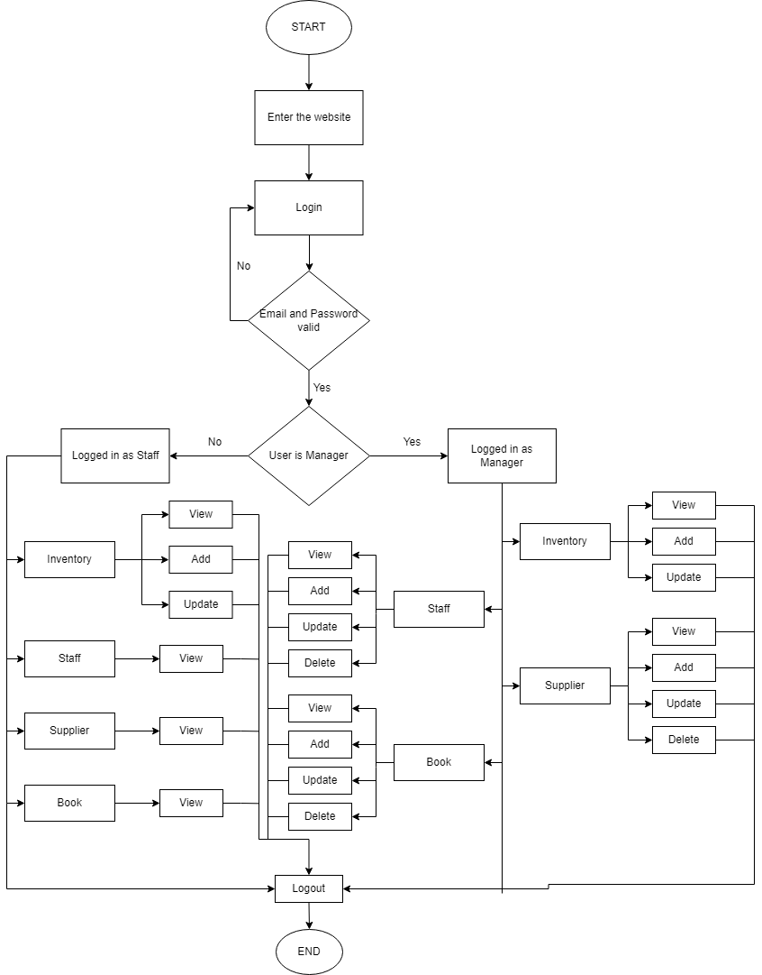
3.1 Flow chart of system

Slide 10
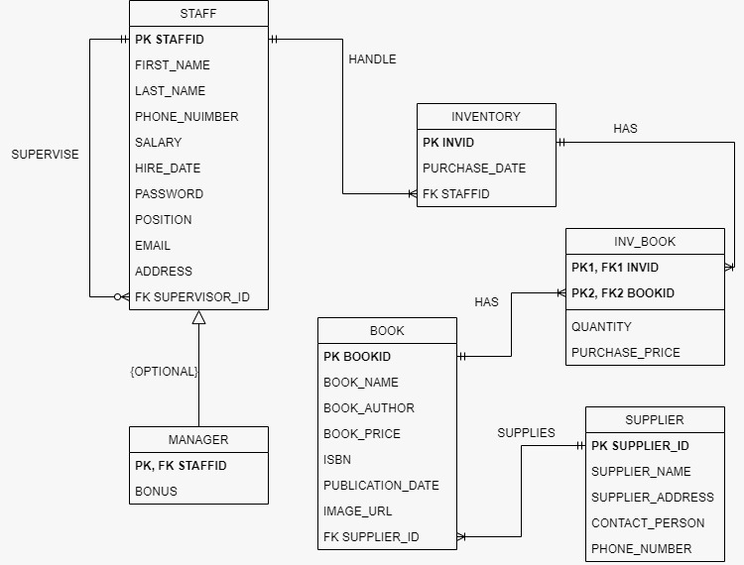
3.2 Entity Relationship Diagram (ERD)

Slide 11
4.0 Conclusion In conclusion, the system has been designed and developed to manage the inventory of a bookstore using Oracle. The use of a database management system allows for easy storage and retrieval of data. Therefore, it is important to plan and design the database carefully, taking into account the specific requirements of the bookstore and the capabilities of the Oracle database management system. Additionally, it is also important to ensure that the database is properly implemented and maintained to ensure reliable and accurate data.

